Slide 1
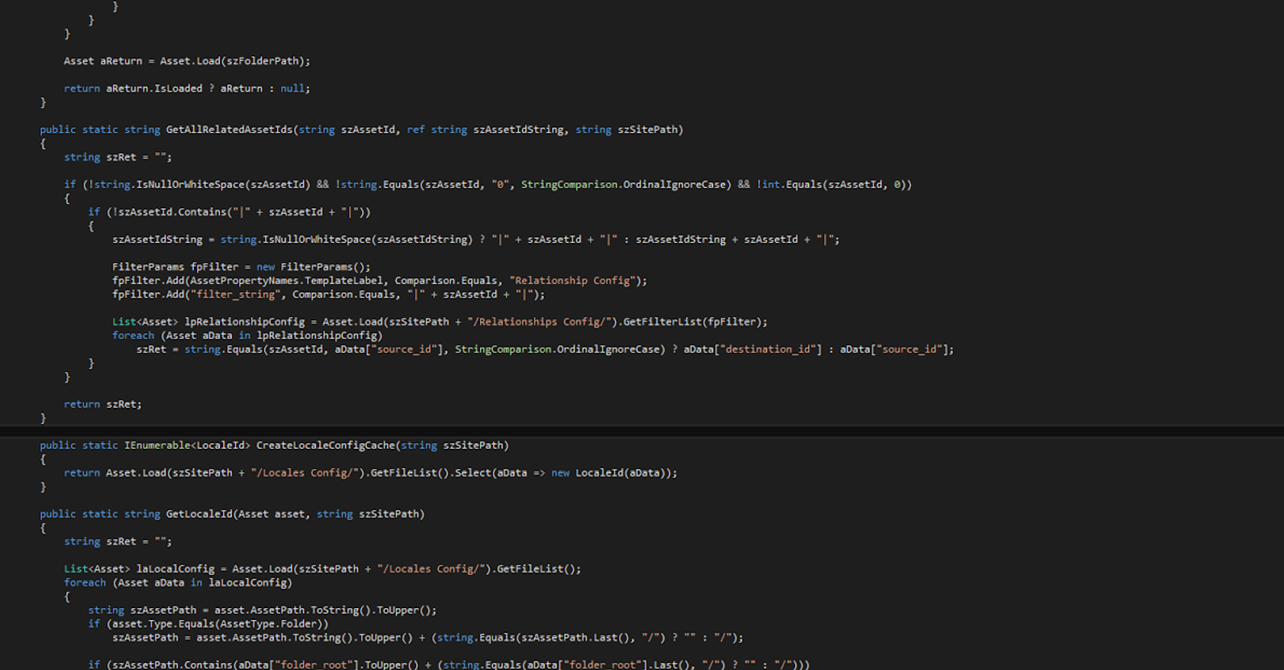
Dr. J. Patrick Desbrow Ed.D.
Technology Roadmaps

Slide 2

ROADMAPS
- INTRODUCTION
Introduction
Technology roadmaps can be used for new products, processes, technology initiatives, and product backlog. Technology manager's use roadmaps to communicate with product management, sales teams, partner networks, and customers.
They can also build confidence with your leadership team showing them you understand the company goals, have performed the detailed planning, and can confidently meet your committed delivery dates.

Slide 3


Section Overview
ROADMAP EXAMPLES

Slide 4
ROADMAPS
- DIFFERENCE TYPES
Vision
Plan
Execute
Release






Roadmaps can be used for different purposes
Long term strategies:
Management teams devise strategies that often challenge company resources
Technology managers typically assist with making these more concrete
The results are themes & goals there must be SMART
Specific, Measureable, Achievable, Relevant, Time bound
These can be applied to a roadmap when this level of detail is present
Most traditional technology roadmaps are strategic
Short term goals:
Translate SMART Goals into groups of projects or Agile epics (less than 3 months)
Projects have beginning and end dates. Add these to the roadmap
These tools visualize the detailed planning that was conducted
They create confidence that you can meet your committed delivery dates.

Slide 5
ROADMAPS
- DIFFERENCE TYPES
Parts of the a traditional strategic technology roadmap
Key Stakeholder or Customer Personas Themes:
Technology manager typically have to spread their resources
Projects are created to meet the needs of many different key stakeholders
These need to be called out as part of the roadmap
Leadership need to believe your teams can execute on all of your commitments
These stakeholders are show in left side labels in the next example
Time & Product Categories:
The time dimension is displayed across the top of the diagram
Each line represents a project with a start & end date illustrated by the length
Different color lines represent different project categories or product offerings

Slide 6
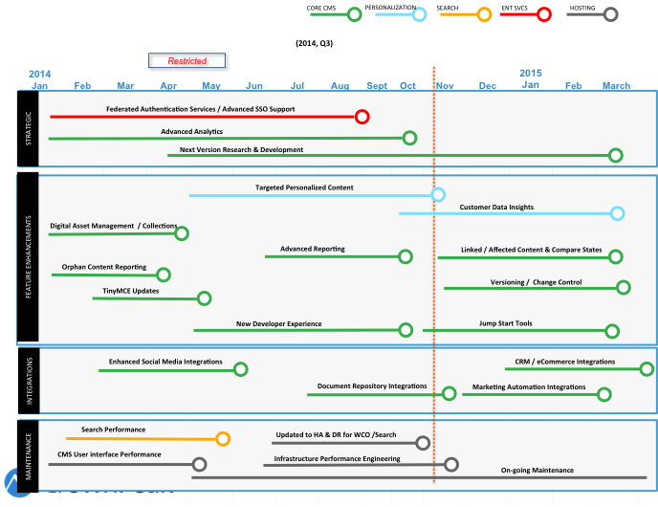
TECHNOLOGY
- ROADMAP
Roadmap Themes
Strategic
Feature Enhancements
Integrations
Maintenance
Product Offerings
Content Management (CMS)
Personalization (WCO)
Search
Enterprise Services
Hosting

Slide 7
ROADMAPS
- DIFFERENCE TYPES
Parts of the a tactical technology roadmap
Key Stakeholder or Customer Personas Themes:
This view will focus on one key stakeholder group or one product feature grouping
This allows for a greater level of detail
Ensure the focus on the tactical roadmap is clearly labeled
Expect to create one roadmap for each grouping such as the next examples
Time & Product Categories:
Segment each tactical roadmap into blocks tagged with the commitment dates
Each block represents a project with a start & end date
Different color blocks represent different categorizations such as financial quarters

Slide 8
TECHNOLOGY
- ROADMAP
Product Improvements
ETA JAN
ETA FEB
ETA MAR
Visual Studio Integrations
Debug & Profiler Tools
Separation of Environments
15
15
15
ETA APR
ETA MAY
ETA JUN
Jump Start Tools
Field Level
Dependencies
Import / Export Tools
15
15
15
ETA JUL
ETA AUG
ETA SEP
Version Control for
Templates &
Workflow
Branching for
Templates
Version Control for
Global Settings
15
15
15
Note: These dates represent a proposed schedule and are not an official commitment

Slide 9

Technology Roadmap
Dr. J. Patrick Desbrow, Ed.D.

